Slide 1
Client Server Communication Project
Week 3 : Socket Programming

Slide 2
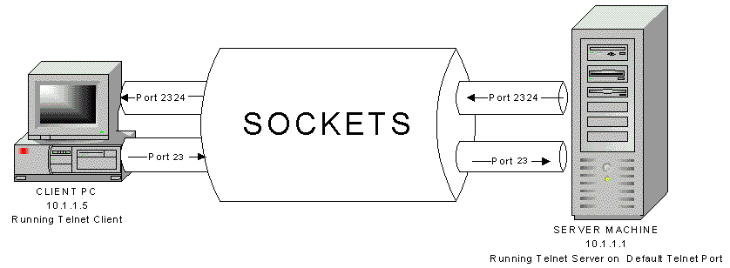
Socket?🤔

Slide 3
Socket is a virtual endpoint of any kind of network communication done between two hosts over in a network
Allow communication between two different processes on the same or different machines.
Can be used in languages such as Java, C++, C, which provides API.
Uniquely identified by an IP address, end-to-end protocol and a port number.

Slide 4
Sockets v/s Ports🤯

Slide 5
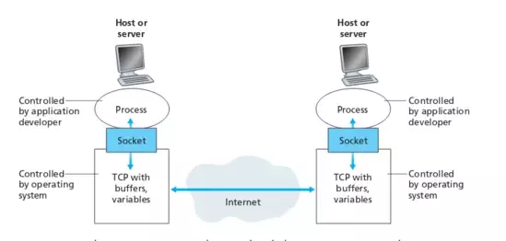
Port is a communication endpoint. Socket is a means to use the endpoint.
Sockets is bound to a port. They provide an interface between network layer and transport layer.

Slide 6

Socket Programming
Socket programming is a programming schema in which sockets are used and manipulated to create a connection between software.

Slide 7
EXAMPLE (NETCAT)

Slide 8
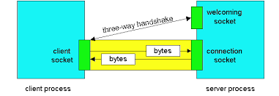
Basic Flow of Client-Server Communication

Slide 9
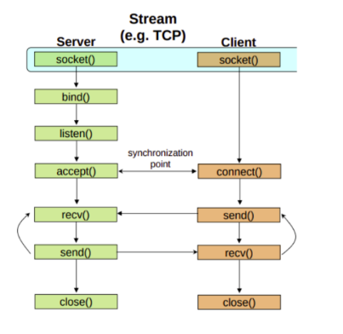
Basic Flow of Client-Server Communication

Slide 10
socket() - Get the file descriptor
Creates an endpoint for communication and returns a file descriptor that refers to that endpoint.
int socketID = socket (Family, Type, Protocol)
Returns socket ID
Family - The domain of communication, like IPv4, IPv6
AF_INET refers to IPv4
Type - Connectionless (SOCK_DGRAM) or Connection - Oriented (SOCK_STREAM)?
Protocol - usually set to 0 (default)

Slide 11
bind() - What port am I on?
Binds the socket to a port, that can be used to send/receive data
int status = bind(socketID, &addressPort, sizeOfPort)
socketID - the ID returned by the socket() call
addressPort - the socket we just created using the sockaddr_in struct
sizeOfPort - the byte size of the socket, found out using sizeof() operator.

Slide 12
listen() - Call me please!
Instructs the TCP implementation to listen for connections.
int status = listen(socketID, queueLimit)
Returns 0 if listening, else -1
socketID - the server socket created initially
queueLimit - number of active participants that can be connected.
It responds immediately i.e. non-blocking.
This socketID is only used for listening not for sending and receiving.

Slide 13
accept() - Thank you for calling!
Creates a socket to accept an incoming client communication
int newID = accept(socketID, &clientAddress, &addressLen)
Returns a new socket ID used to send data back to the client.
socketID - the socket that was listening for any incoming communication
clientAddress - the socket of the client that is trying to connect to the server
This is filled open returning from the function
addressLen - the size of clientAddress, passed as a reference
This is also filled upon returning from the function

Slide 14
recv() and send()
int data = send(socketID, MSG, MSGLen, flags);
Input:
MSG: message we want to send
MSGLen: message length(in bytes)
flags: special options, usually 0
Returns
data: number of bytes transmitted
int data = recv(socketID, recvBuf, bufLen, flags)
Input
recvBuf: stores the receive bytes
bufLen: buffer length
Returns
data: number of bytes received

Slide 15
close() - Bye Bye!
Once we are done with socket, it should be closed
int status = close(socketID)
Returns 0 if successful, else -1
Frees up the port that was bound to the socket

Slide 16
Thank you

Slide 17
connect()
Establish a connection with the server
int status = connect (socketID, &serverAddress, addressLen)
Returns 0 for a successful connection, else -1
socketID - the client socket ID
serverAddress - the socket struct of the server
addressLen - the size of serverAddress.

